Slide 1
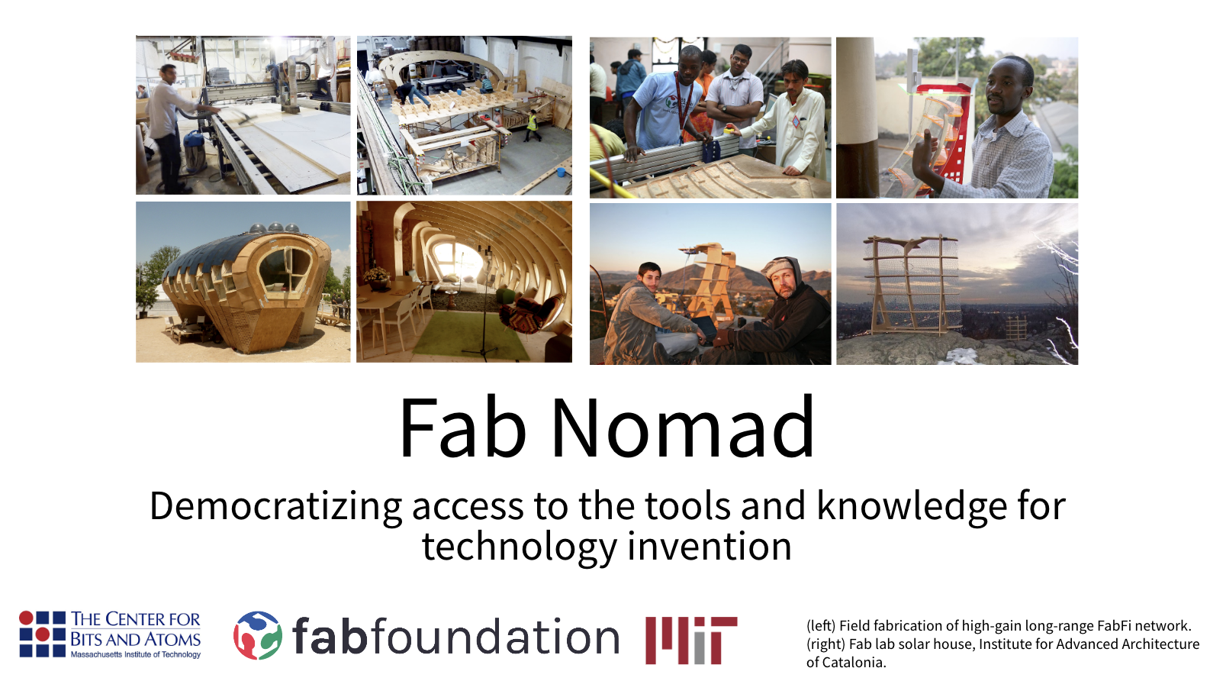
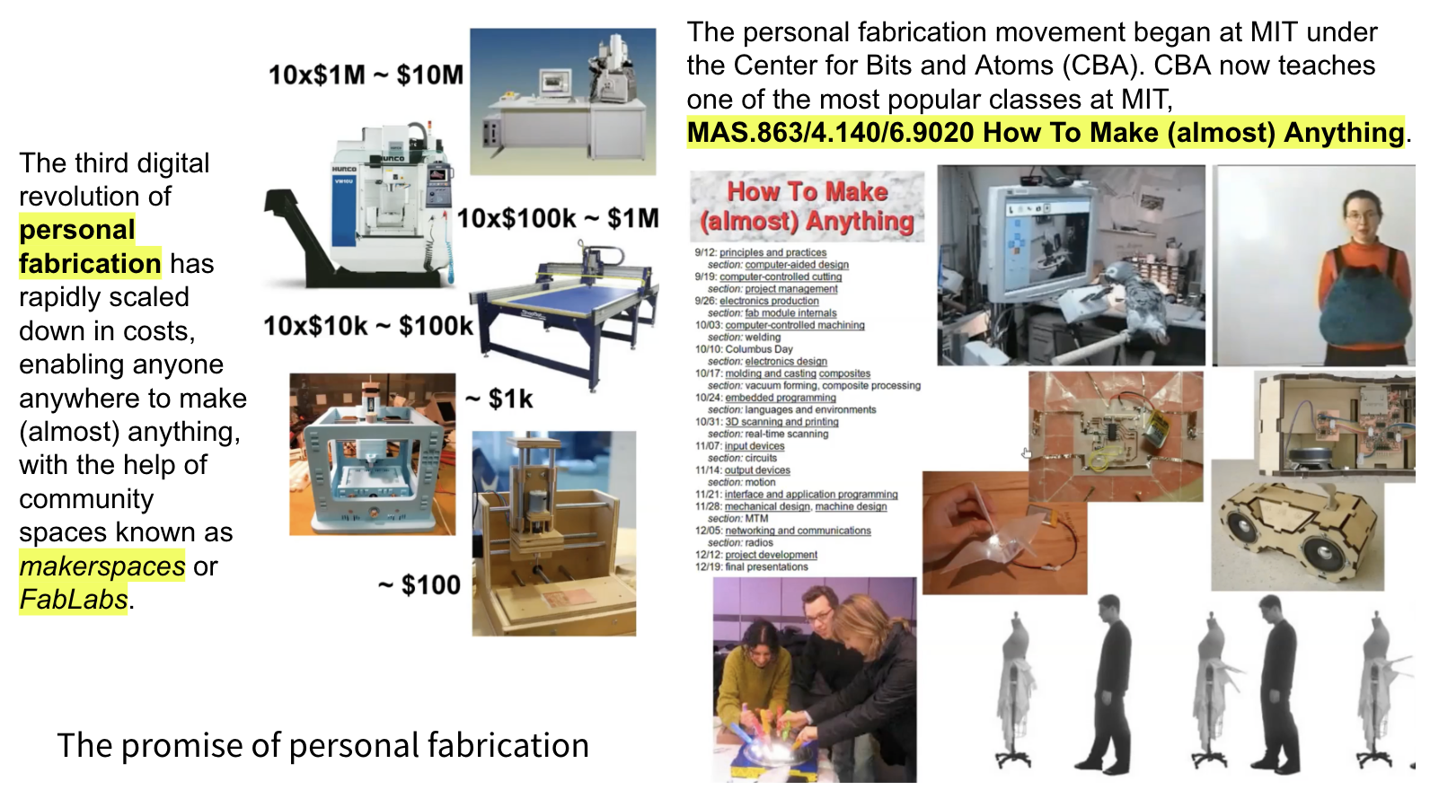
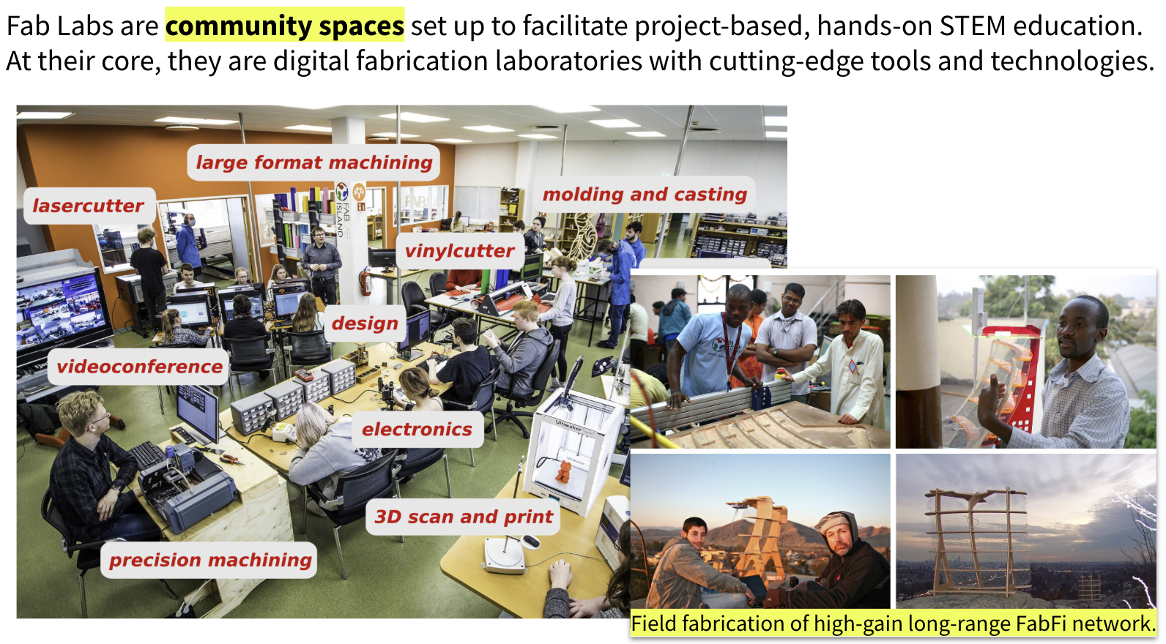
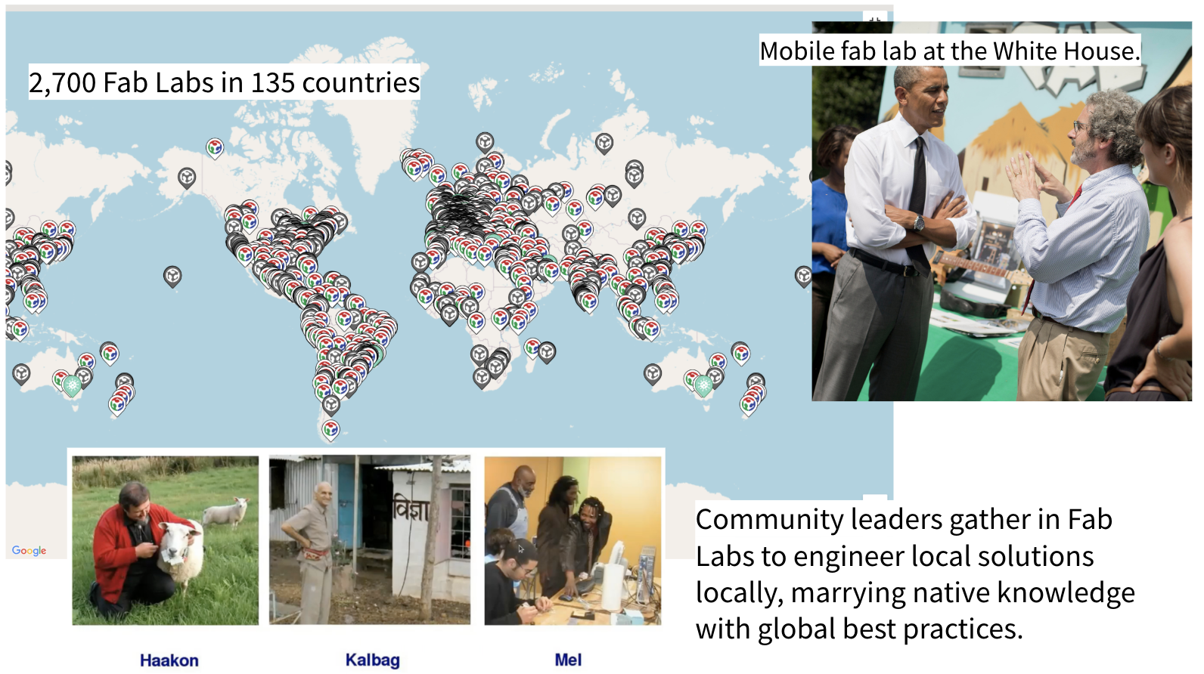
Notes:
Fab Nomad between 09/2024 – 09/2025

Slide 2
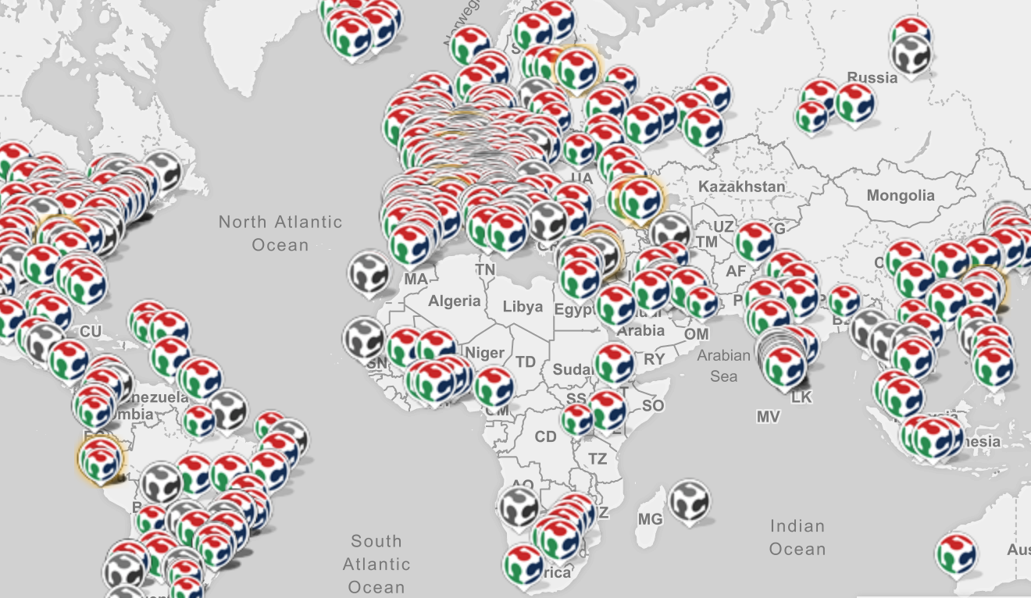
Roadmap
Shenzhen, China
Bhutan
Pabal, India
Kamakura, Japan
Amazon Rainforest
Barcelona, Spain
Amsterdam, The Netherlands
Northern Norway / Iceland

Slide 3
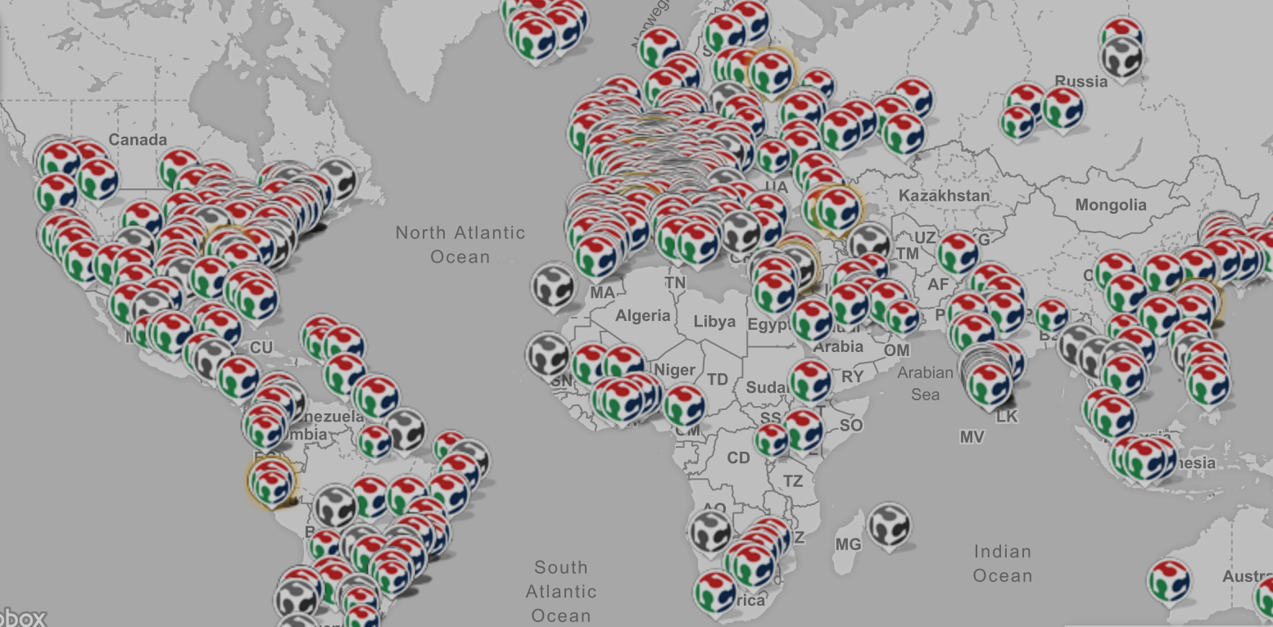
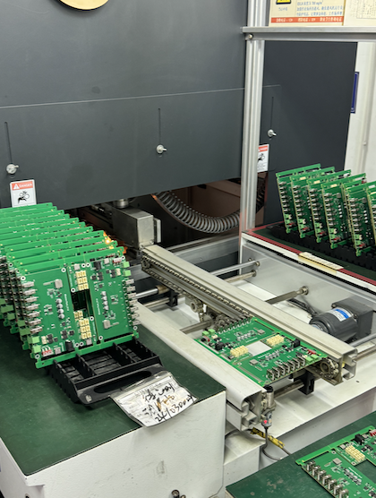
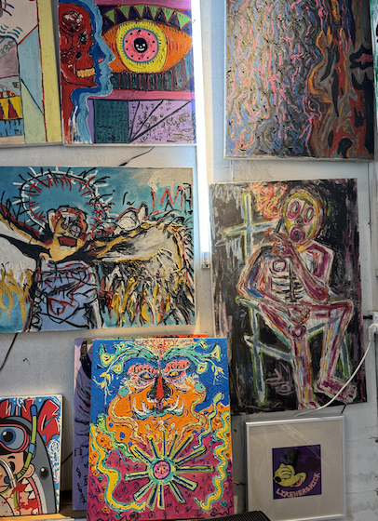
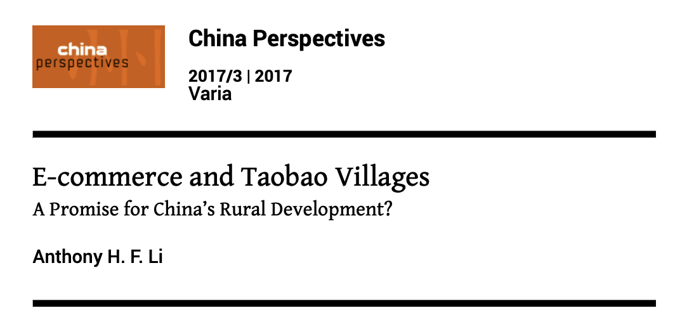
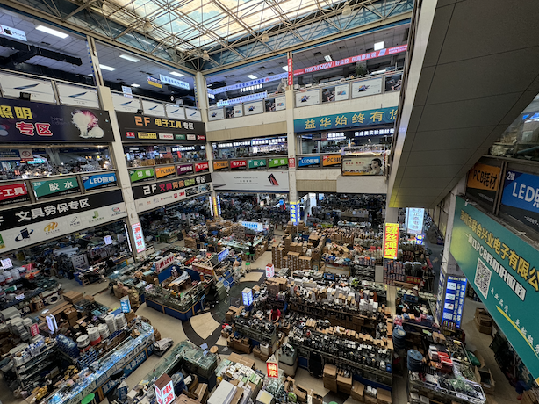
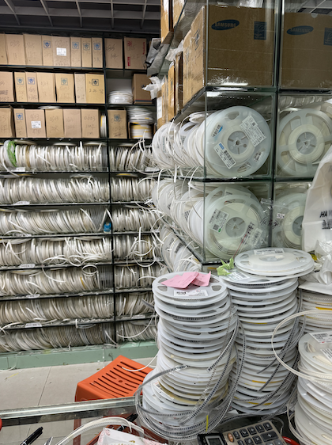
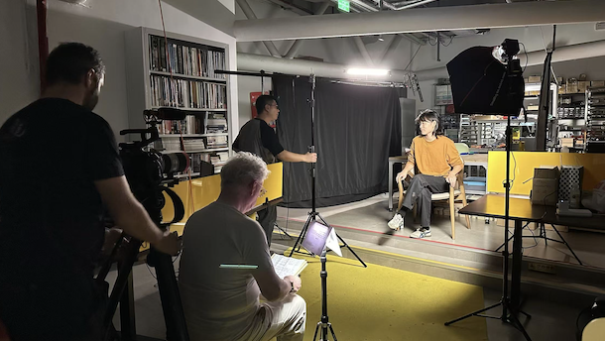
Shenzhen, China
manufacturing, intellectual property, open source development, shanzhai, democratization of technology (& art)
Rural Dynamism
PCB Manufacturing
Dafen Art Village
Huaqiangbei Electronics Marketplace
Component Reels
Malcolm Clarke and Han Yi, ARTeFACT
Notes:
09/2024 – 11/2024

Slide 4
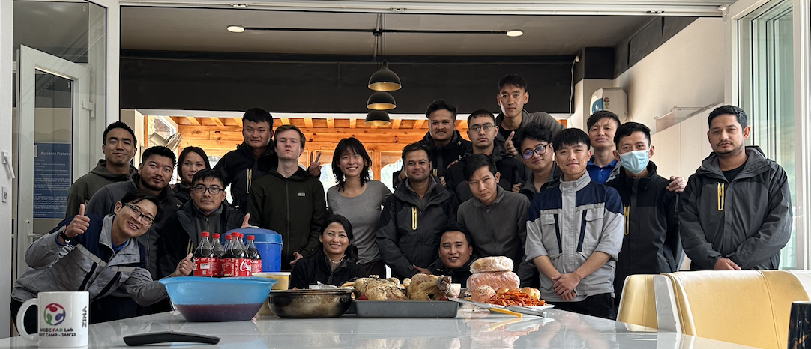
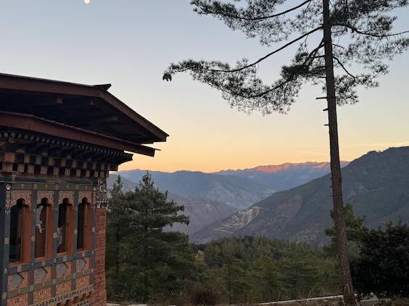
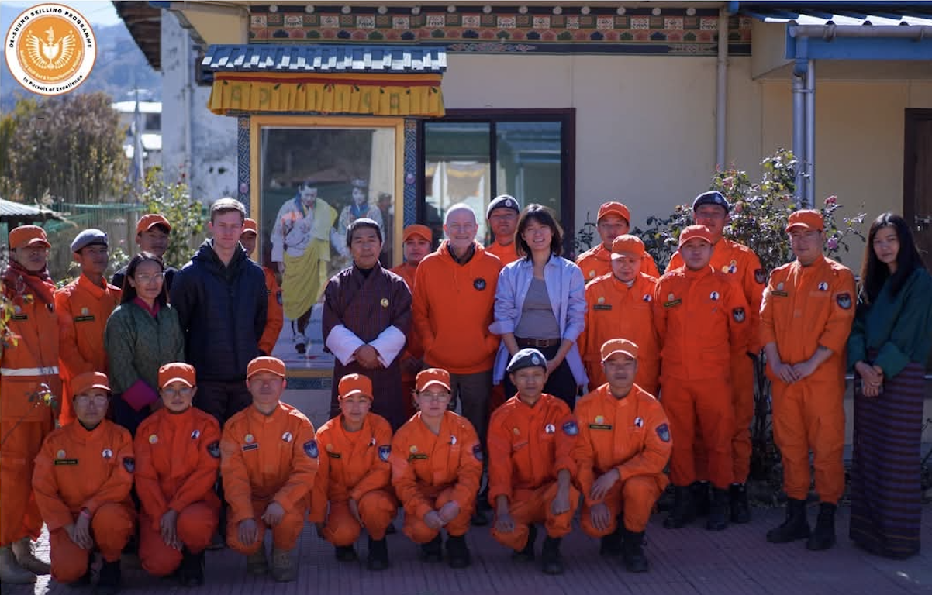
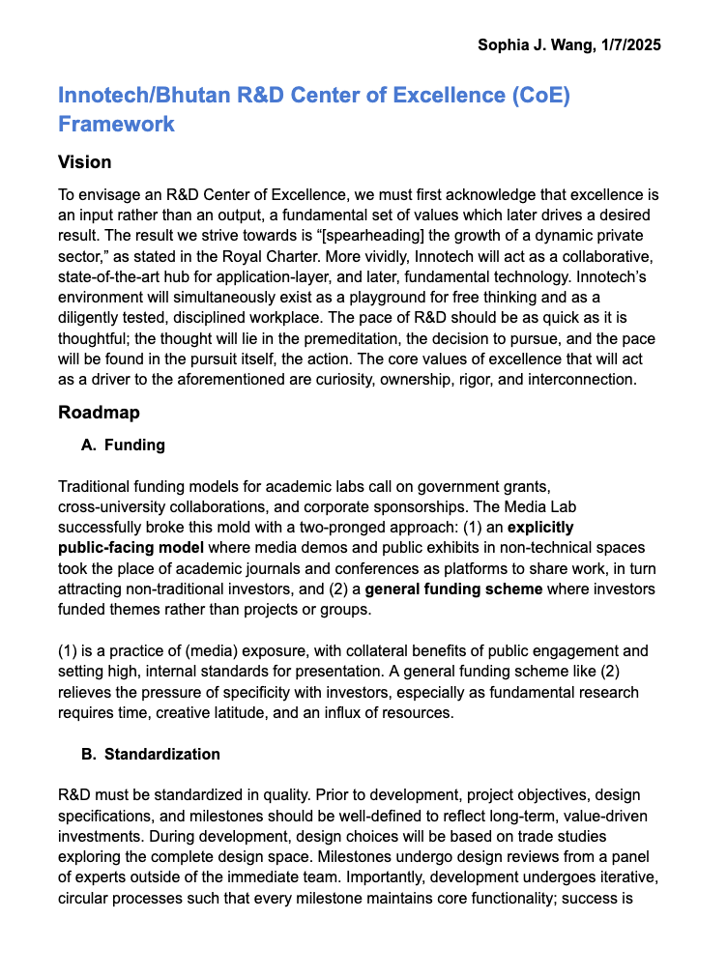
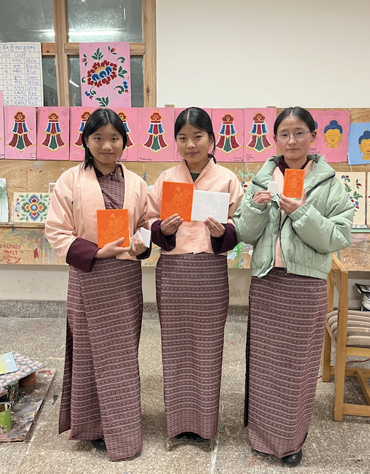
Bhutan
mindful development, sustainability, nascent R&D ecosystem, long term thinking/SAR “playground” for courageous new paradigms
Innotech and JNWSFL
Dungkar Dzong
Skilling Programme with Chef William Yosses
Center of Excellence (CoE) Framework for Bhutan R&D
Royal Academy FabLab
Notes:
11/2024 – 01/2025

Slide 5
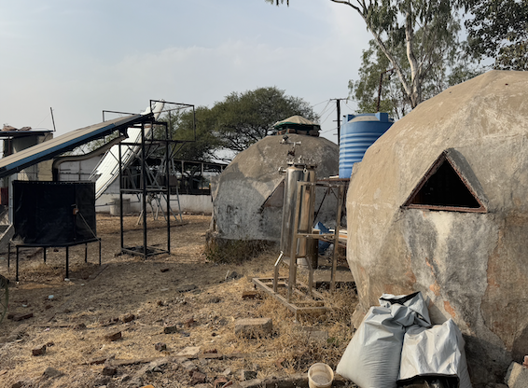
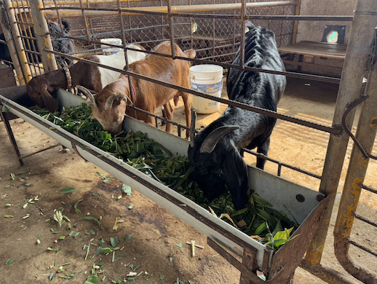
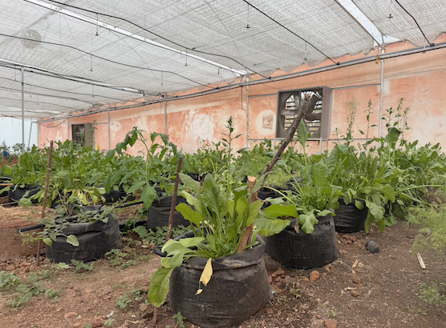

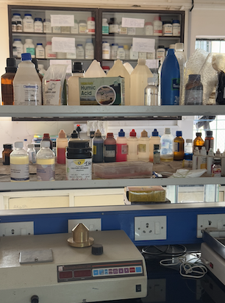
Pabal, India
Self sufficient “Fab City”, smart agriculture, energy, water, education, and entrepreneurship – scaled to a village.
Locally fabricated earthquake-resistant housing
Animal husbandry
Polyhouse
Black Soldier Fly composting
BioLab – nutrition, agro, tissue
Notes:
01/2025 – 02/2025

Slide 6
Amazon Rainforest
Floating FabLab
natural capital accounting, genetic biodiversity bank, reaching indigenous makers

Slide 7
Barcelona, Spain
Institute for Advanced Architecture of Catalonia
citizen science, participatory research/co-design, material circularity in architectural design + construction

Slide 8
Amsterdam, The Netherlands
Waag Futurelab
satellite imaging, digital policies, demographic participation, data transparency, European Union

Slide 9
Kamakura, Japan
Northern Norway/Iceland

Slide 11
Full state space exploration of
technology x culture x infrastructure x policy
Notes:
Perspectives to bring beyond Singapore, Abu Dhabi, and Japan

Slide 12
Alþingi, Parliament House of Iceland
Barcelona City Council
City of Amsterdam
CLICKNL
DaFen Village Art Studio
Dassault Systems
De-suung Skilling Programme (DSP)
Department of Employment and Entrepreneurship, Bhutan
Department of Sciences and Technology, Government of India
Druk Holding and Investments (DHI)
Druk Gyalpos Institute (DGI)
European Commission
European Union Agency for the Space Programme
Fab City
Gelephu Mindfulness City (GMC)
Global Alliance for a Sustainable Planet
Grant for the Web
Institute for Advanced Architecture of Catalonia (IAAC) UNICEF
Materiom
Ministry of Education, Culture and Science, The Netherlands
Norwegian University of Science and Technology
Praj Foundation
Seeed Studios
Space Iceland
Southern University of Science and Technology (SUSTECH), Shenzhen, China
Symbiocreacion
Tsinghua University
United Nations Sustainable Development Group
WASP
Notes:
Organizations I’ll have worked with by the end of this year.

